Slide 1


L2: Statistics
Digital Health
UCSD Extension – Specialization Certificate
Data Science for Healthcare
Hobson Lane, UC San Diego
Instructor

Slide 2
Syllabus
Wk. | Title | Topics | Exercise
0 | Data Science in Healthcare | applications, terminology, HIPPA | anonymize dataset PII
1 | Spreadsheet Data Science | ETL, exploration & visualization | height, weight, BMI, gender
2 | Statistics | causality, correlation, MLE | causal diagram “games”
3 | Clinical Data Science & Machine Learning | PII, prescriptive vs descriptive | predict diabetes risk
4 | Deep Learning & AI | neural nets, radiology, CV | train diagnostic neural net
4 | Hospital Performance Modeling | time series, unintended conseq. | Mid-term Quiz!
5 | Population Health (Epidemiology) | GIS, spatio-temporal modeling | visualize/analyze Ebola
6 | Scoping Review & Gap Analyses | diabetes, military women | review smoking research
8 | Natural Language Processing | IA, summarization, text mining | find summary with spaCy
9 | Occ. Health & Assistive Tech. | Tesla & Aira case studies, OSHA | analyze medicine OCR app.
10 | Policy, Privacy and Ethics | bias, fairness, anonymization | Final Exam!
Proj | Train your own healthcare model | find/download data, ETL, | fit/train a DS model

Slide 3
What is statistics?
How is statistics used in healthcare?

Slide 4
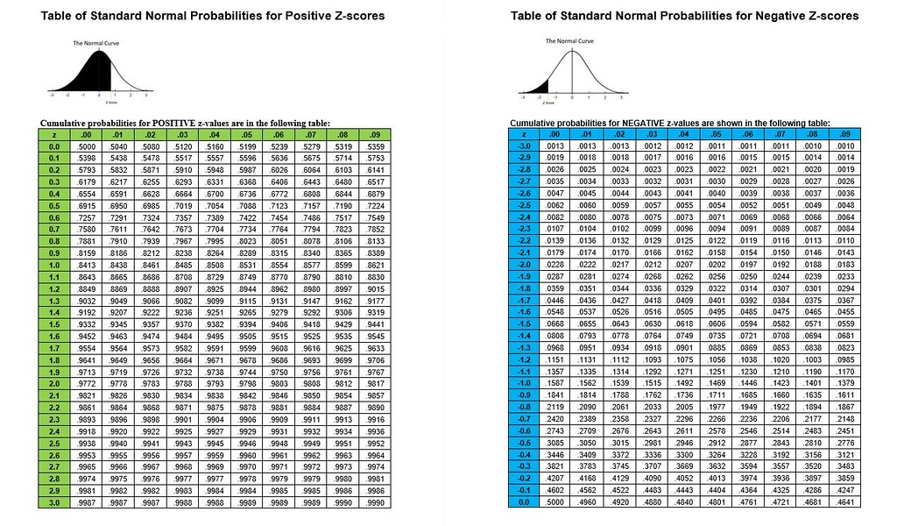
Probability Distribution

Slide 5
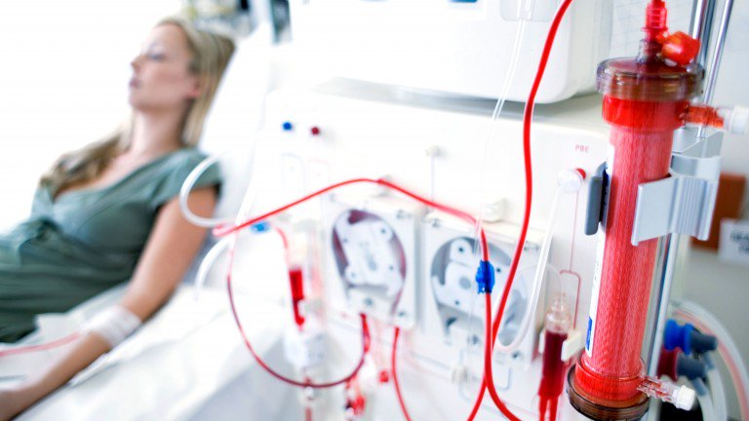
Ethics and Accuracy
Clinical records can predict Kidney failure
2 days in advance
55% accuracy for acute problems
90% accuracy for serious issues
Dataset:
100% UK citizens
100% military
90% male
DeepMind (London)

Slide 6
Berkson’s Paradox
 | General Population |  |  |  | Hospitalization past 6 mo
 | Bone Disease | No Bone Disease | % Bone Disease |  | Bone Disease | No Bone Disease | % Bone Disease
Lung disease | 17 | 207 | 7.6% |  | 5 | 15 | 25.0%
No lung disease | 184 | 2,376 | 7.2% |  | 18 | 219 | 7.6%

Slide 7
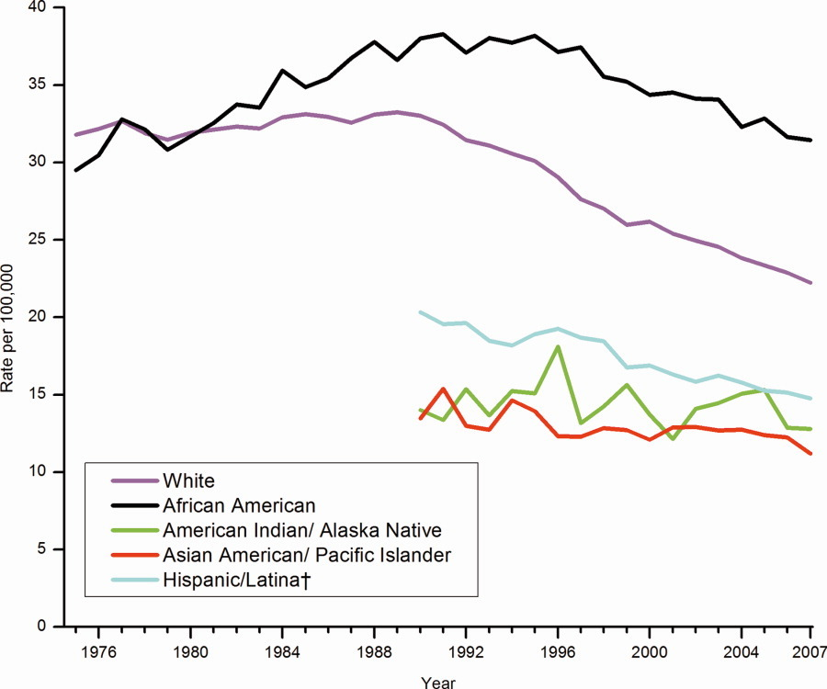
Correlation enables prediction
Breast Cancer Rates 2011: bit.ly/ucsdbreast

Slide 8
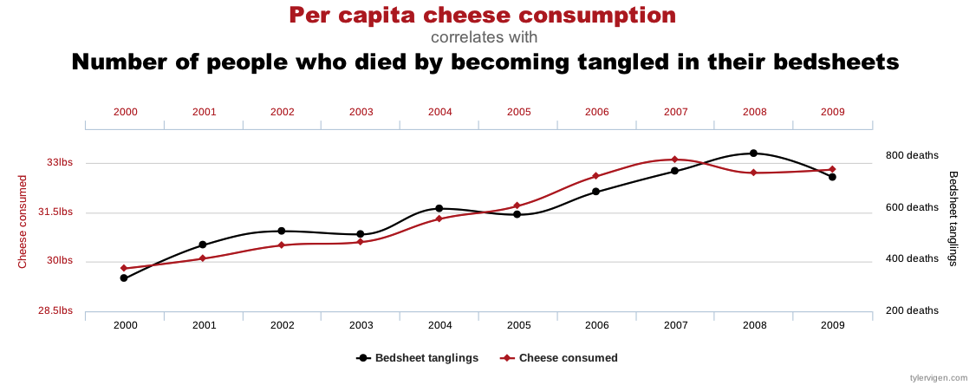
Correlation is not enough
Computers are good at finding patterns
But often those patterns are “spurious correlation”

Slide 9
Bayes Rule
Updated Probability = Likelihood Ratio x Prior Probability

Slide 10
Bayes Rule Example
Prior | P(D) | Probability of getting breast cancer | 1 in 700 per yr 1 in 70,000 (men)
Sensitivity | P(T|D) | Probability of mammogram detecting cancer | .73
False Positive Rate (False Alarm) | P(T|~D) | Probability of positive mammogram w/o cancer | .12
 | P(T) = P(D) * P(T|D) + P(~D) * P(T|~D) | Probability of a positive mammogram among all women | .73 * 1 / 700 + .27 * 699 / 700 = .121

Slide 11
Mammograms can cause harm!
P(D) | 1/700
P(T|D) | .73
P(T) | .121
ACP: biannually after age 50+
previously: annual exams at 40+

Slide 12
Assignments

Slide 13
Quiz
Why is understanding Baye’s Rule so important?

Slide 14
Homework: Create diabetes MLE
Download diabetes dataset: http://totalgood.org/midata/...

